Slide 1


Slide 2

PARENT INVOLVEMENT POLICY-COMPACT
&
BUDGET UPDATES

Slide 3


PIPs & COMPACTS
NEXT STEPS:
ALL PIPs and Compacts have to be collected
Notes:
Thank schools that submitted documents by the deadline. Deadline to submit PIPs and Compacts was December 6. Not all schools have turned in the PIP and compacts. If you are one of the those schools, we urge to submit them as soon as possible.

Slide 4
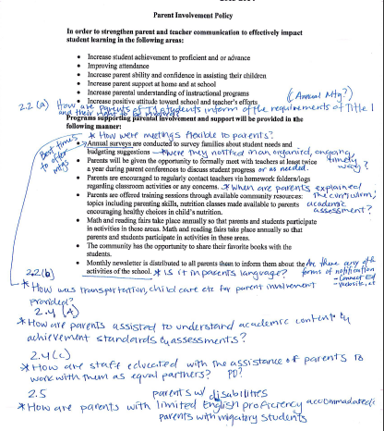
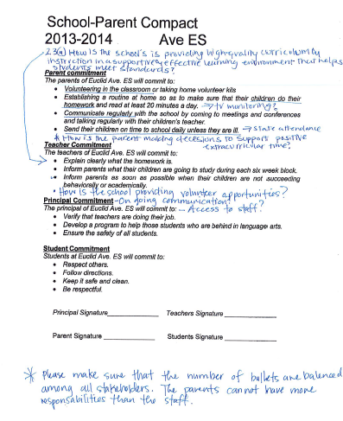
PIPs & COMPACTS
Each Coach will review for quality and compliance
Notes:
Revisions for quality and compliance. CDE monitoring instrument for compliance and documents distributed at previous meeting for quality. Also in our website.

Slide 5
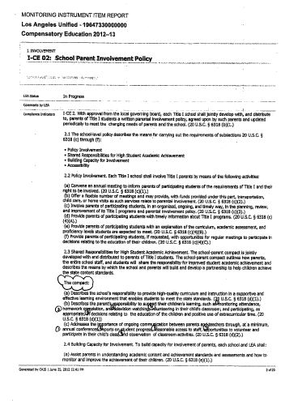
CDE MONITORING INSTRUMENT

Slide 6

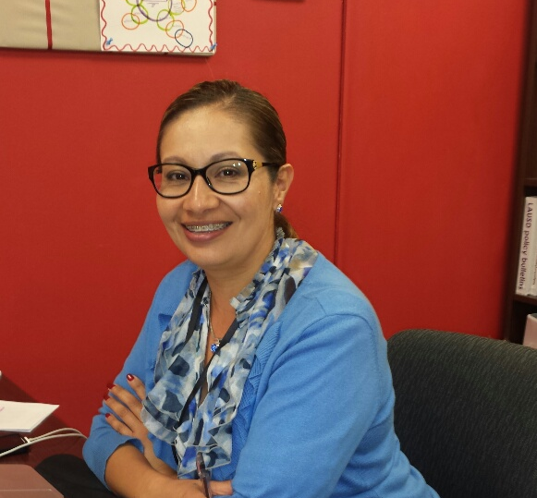
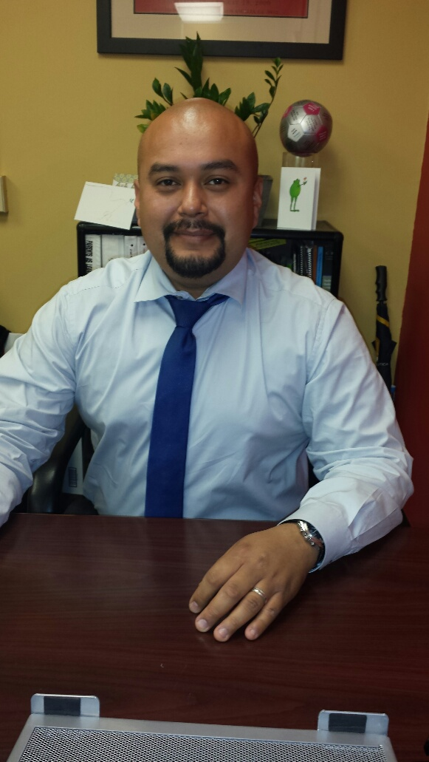

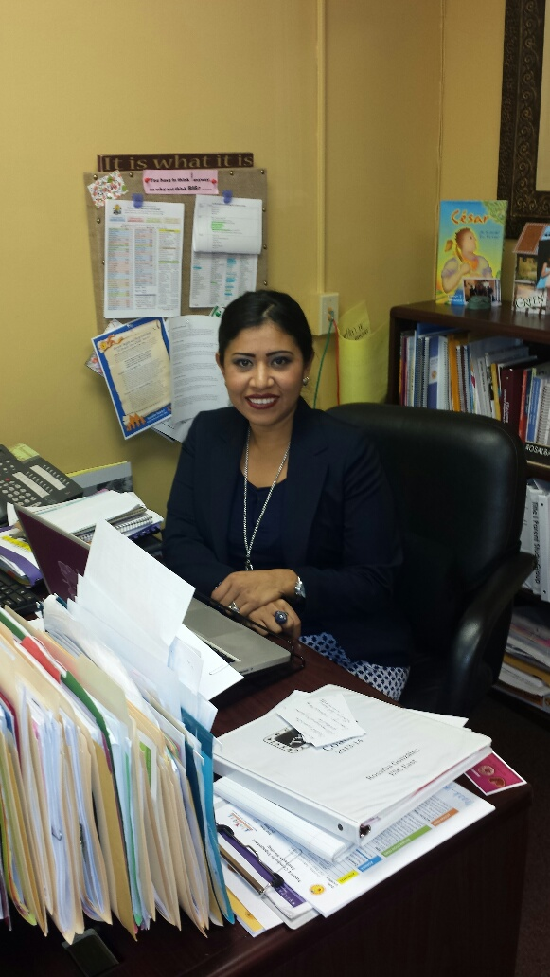
PIPs & COMPACTS
Notes:
-Coaches will contact schools whose PIPs and compacts need revisions with targeted feedback.

Slide 7
NOT ALL SCHOOLS
Resubmission of PIP and Compact:
Notice/ invitation
Agenda
Hand-outs
Sign-in sheets
Minutes/ notes documenting parent involvement of discussions and approval of Title I parents
Name this file:
“RevisedYOURSCHOOLNAME13-14 PIP”
“RevisedYOURSCHOOLNAME13-14 COMPACT”
PDF FILES
This process might happen more than once.
Notes:
Make it clear only schools who have been contacted by your coach need to resubmit paperwork. Not everyone needs to resubmit ONLY those schools that have been contacted by their coach indicating that PIP and compact need revisions. Handout: coach caseload sheet.

Slide 8
PIPs & COMPACTS
FINAL DEADLINE
FOR
PIPs & COMPACTS SUBMITION TO CDE WEBSITE
April 15
Notes:
IT’S NOT OUR DEADLINE – EVERYTHING IS HAS TO BE UPLOADED TO THE CDE WEBSITE. IN THE EVENT THAT YOU ARE IN THE MIDDLE OF THE PROCESS, WE WILL UPLOAD THE LATEST COPY WE HAVE.

Slide 9

BUDGET

Slide 10
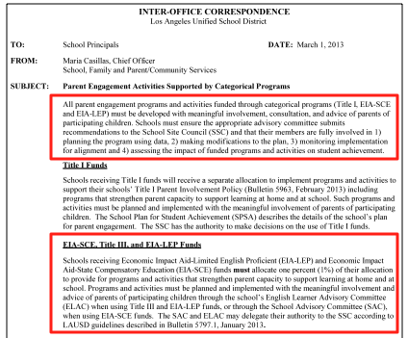
BUDGET
Notes:
Reminder that ALL parent engagement programs and activities funded through categorical programs(Title I, EIA-SCE (economic Impact Aid-State Compensatory Education) AND EIA-LEP)must be developed with meaningful involvement, consultation, and advice of parents of participating children.

Slide 11


BUDGET
Funds allocated for parent involvement activities must not be used for other purposes.
When used inappropriately, the categorical program from which the non-allowable item was expended must be repaid with the general fund’s regular program resources.
Notes:
Funds should be allocated to support parent activities that help meet the school goals for parent engagement. As making budget adjustment request, note that all expenditures on funding code E046 must be aligned with parent engagement.
IMA specific for Parent training/engagement. We don’t know the allowable items for next year but are not going to be too different from this year. The conversation at your school could be, how might we aligned $$ to our parent engagement goals?

Slide 12
Parent and Community Engagement
ESC East
(323) 224-3320

